Slide 1

Agent Activity Chart
2/9/2023 10:06 PM
Print User : automation
Page 1 of 3

Slide 2
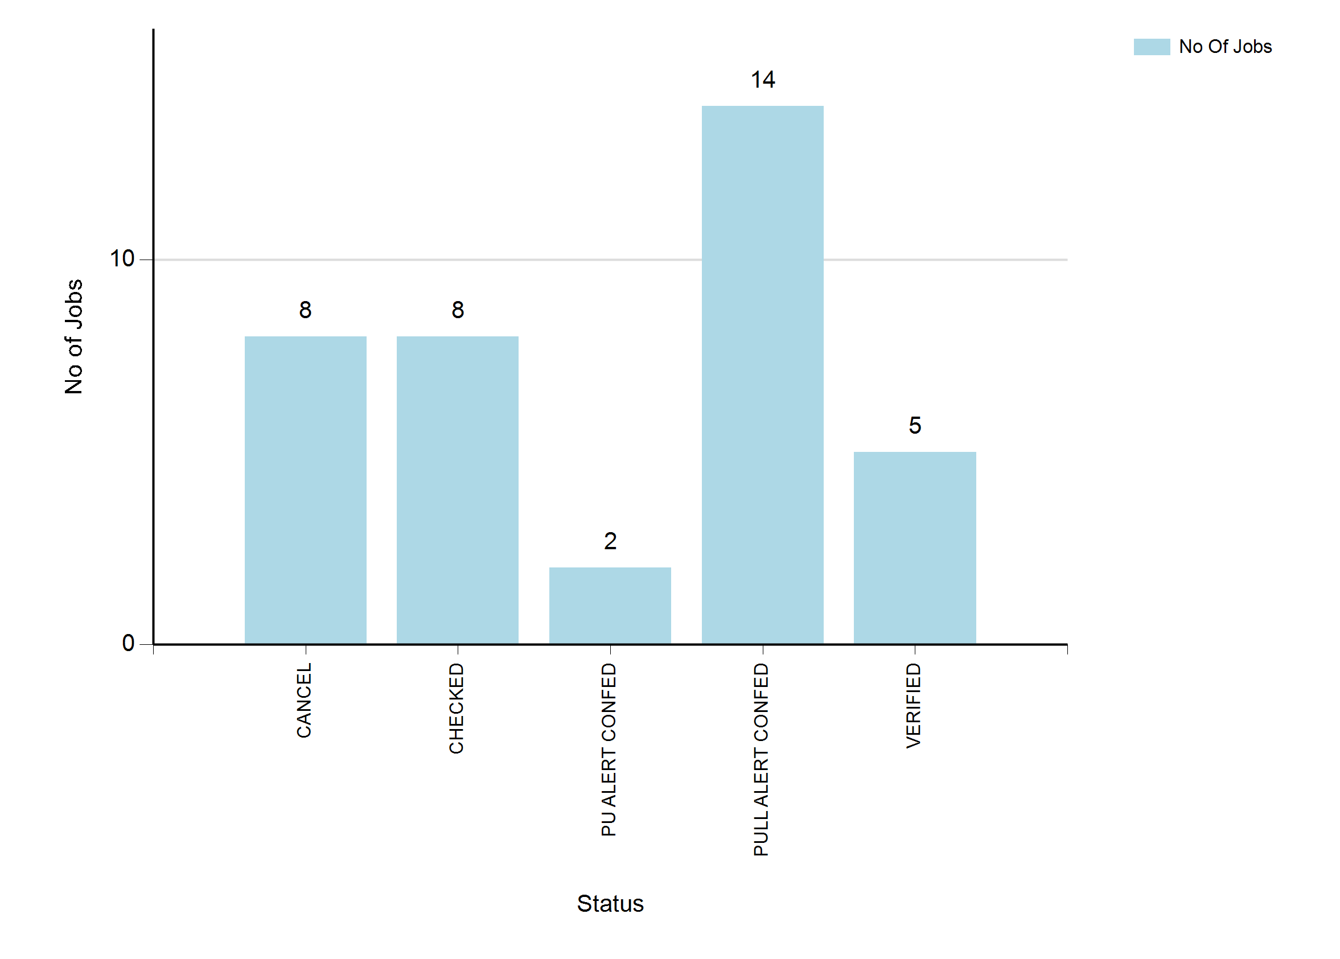
2/9/2023 10:06 PM
Print User : automation
Page 2 of 3

Slide 3
2/9/2023 10:06 PM
Print User : automation
Page 3 of 3

